Slide 1
Introduction to the LEAD Process and Methods
Notes:
Acknowledge hard work of the TTs in developing work plans
Warn that this is a presentation is participatory

Slide 2
Initial Workshop Goals and Objectives
Goal
Design and implement leadership and management interventions to improve malaria elimination engagement, accountability, and service delivery
Objectives
Identify and prioritize key program management challenges and opportunities for individuals and teams
Get expert input on challenges when transitioning from malaria control to malaria elimination
Form a cross sectional and cross hierarchical Task Team to refine and implement action plans
Notes:
In order to set the stage and make sure we are all working from the same foundation
Monitoring is a continuous, ongoing process involving the collection of data at multiple points during a planning cycle, starts with the collection of baseline data at the beginning
Evaluation is an exercise done at the end of a program to help you understand how and to what extent a program is responsible for particular results, requires the collection of data at baseline and at the end of a program
Formal evaluation involves a control or comparison group
In the absence of that, we can say the work of the Task Team contributed to any resulting change but cannot fully attribute those changes to your work
Monitoring should be done at every stage with data collected, analyzed, and used on a continuous basis.

Slide 3
LEAD Framework Key Features
Collaborative and iterative process
Ongoing review and adjustments
Quality improvement
Action learning
Reflective practice
Notes:
A benchmark from which you can measure progress

Slide 4
The Lead Framework Process
Notes:
Can anyone define what an indicator is? It is a sign of progress – used to determine whether a program is achieving its objectives
Qualitative: help to supplement numbers/percentages provided by quantitative
What is the difference between process, outcome, and impact indicators?
Process: measure activities carried out to achieve a program objective, butts in a seat! But what have the people have been trained done with their knowledge/skills, how have they changed their behavior
Outcome: immediate results through the execution of activities
Impact: long-term effects or end results of a program, e.g. change in health status, reduction in mortality, morbidity

Slide 5
Task Team Action Plan
Key Challenges & Opportunities Addressed by Action Plan | Activities | Quantitative Indicators | Baseline Data | Target | Endline Data | Data Source | Who Will Collect? | By When? | Progress
Notes:
I would like to hear from each task team how they went about selecting indictors.
Practical: can be collected on a timely basis and at a reasonable cost
Independent: non-directional, can vary in any direction, e.g. # of people using LLINs rather than an increase in the # of people using LLINs
Reliable: can be measured repeatedly with precision by different people
Relevant: extent to which a result can be attributed to an activity
Linkage of action plan indicators to national, regional, global indicators: Henry will cover this.

Slide 6
Main LEAD Elements
Initial and follow-up workshops with a cross-section of NMCP personnel; 3-5 meetings for a core group (Task Team)
Identification and implementation of solutions to address specific challenges and opportunities identified at the workshops
Evaluation measures

Slide 7
Techniques and Activities Used During Workshops
Re-creation of the ‘system in the room’
Active listening
Friendly consulting
Process mapping
Quality improvement techniques
  Root cause analysis
    Fish bone analysis
    Brainstorming
    Flow charts
    Cause and effect diagrams
    5 Whys
  Plan-Do-Study-Act cycle
Notes:
What kind of indicators are the first 3 indicators?
Refined 2nd b/c not only about that the visit was conducted but that problems were solved/assistance was provided, value of qual data to supplement this
4th: baseline was 89%, target was 100%
Barriers to success: lack of malaria case management chart sourced for
I would refine the indicator to lack of training and supplies for case management, once it become clear that lack of malaria drugs/case mgmt. charts were an issue
What specifically about surveillance do the trainings cover? Is there some sort of metric to see improvement in surveillance? I know that there is also the metric below about timeliness/completeness of reporting below.

Slide 8
Quality Improvement (QI) Overview
Prioritizing Root Causes and Interventions
Notes:
Acknowledge hard work of the TTs in developing work plans
Warn that this is a presentation is participatory

Slide 9
Quality Improvement Aims
Quality improvement seeks to answer three central questions:
How can we make quality improvement a routine, rather than reactive approach to addressing gaps in service delivery?
How can we strengthen health systems to deliver optimal outcomes?
How can we achieve large-scale impact together with long-term sustainability?
Notes:
For Rundu: According to the CHWs reporting tool, a total of 3758 Household members over 12 years and above received health education

Slide 10
What is the problem?
“Health care interventions that are known to work and save lives are not being implemented for every patient every time. We must address this gap between knowing and doing.”
-Institute of Medicine: Crossing the Quality Chasm Report
QI seeks to close the “know-do” gap.
The know-do gap – how what we know differs from what we do
What we know
What we do
Notes:
Question: Is this for outreach, IRS, ACD, larviciding, or all 4 activities?
How might we refine this challenge and the indicator?
Is it that the outreach activities can’t be completed? So maybe could be % of outreach activities that could be completed vs. # of activities planned?

Slide 11
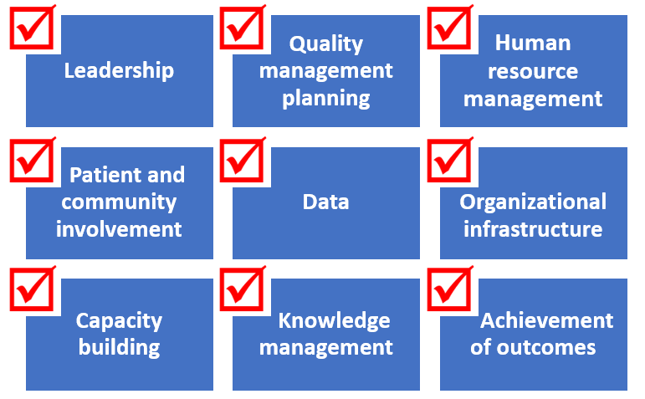
Quality Management: Key Program Elements
Source: HEALTHQUAL
Notes:
What about completeness? Could it just be that the person reviewing the data provided feedback to any hf w/ incomplete data?
Could the visits be narrowed down to the hf that are late or providing incomplete reports? 3 of 35 in Rundu?
Is there a feedback loop to the hf from the person reviewing the reports regarding timeliness/completeness?
DHIS2 for Nankudu

Slide 12
Quality Improvement Principles
Fundamental concept of improvement:
“Every system is perfectly designed to achieve exactly the result it achieves.”
-W. Edwards Deming
Principles of improvement:
Understanding work in terms of processes and systems
Developing solutions by teams of providers and patients
Focusing on patient needs
Testing and measuring effects of change
Peer learning
Source: HEALTHQUAL, Quality Improvement: A Refresher
Notes:
Not just about holding meetings, what is your overall goal? Activating other groups to get involved?
# of new stakeholders involved in malaria activities. Are some existing while others are new stakeholders? (E8, DAPP, SFH, ELCIN Malaria, JC Flowers)
# of new malaria activities incorporated into CACOC and RACOC activities (Is the baseline currently zero or are there already some ongoing malaria activities?)
Reward best performing community (zero refusal),facilities and health care workers e.g. Certificates of appreciation

Slide 13
A Model for Improvement (PDSA)
Source: HEALTHQUAL, Quality Improvement: A Refresher

Slide 14
PROBLEM: What is the problem or gap we’ve identified in our system?
PDSA
AIM:
What process or outcome are we trying to improve?
ACT
We adopt, adapt, or abandon the change?
What needs to be modified before the next PDSA cycle?
What should the next PDSA cycle test?
PLAN
What change are we testing?
Who are we testing the change on?
When are we testing?
Where are we testing?
What data do we need to collect?
Who will collect the data?
When will the data be collected?
Where will the data be collected?
MEASUREMENT:
How will we know that a change will result in improvement?
STUDY
Analyze all data, and summarize lessons learned.
Did the change result in measurable improvement?
DO
What was done to implement the change?
Was the change implemented as planned?
What and where are the barriers to implementation?
Was the change acceptable to staff and patients?
Source: HEALTHQUAL, Quality Improvement: A Refresher

Slide 15
Systems Thinking
Resources (Inputs)
Activities (Processes)
Results (Outcomes)
People
Infrastructure
Materials
Information
Technology
What is done
How it is done
Health services delivered
Changes in health behavior
Changes in health status
Patient satisfaction
Source: Donabedian, A. Explorations in Quality Assessment and Monitoring Vol . 1. The Definition of Quality and Approaches to Its Assessment. Ann Arbor, MI: Health Administration Press, 1980.
Notes:
For Rundu: According to the CHWs reporting tool, a total of 3758 Household members over 12 years and above received health education

Slide 16
Why measure?
Separates what you think is happening from what is really happening
Establishes a baseline: It’s ok to start out with low scores!
Helps avoid putting ineffective solutions in place
To monitor improvements and prevent slippage
Indicate whether changes lead to improvements
Standardized measures allow for comparing performance across sites
Notes:
For Rundu: According to the CHWs reporting tool, a total of 3758 Household members over 12 years and above received health education

