Slide 1
Module 3: Solution Generation and Challenge Resolution
Notes:
Acknowledge hard work of the TTs in developing work plans
Warn that this is a presentation is participatory

Slide 2
Performance Measurement
Notes:
Acknowledge hard work of the TTs in developing work plans
Warn that this is a presentation is participatory

Slide 3
Learning Objectives
Understand the importance of performance measurement (PM)
Understand the types of data
Understand how to develop performance indicators
Notes:
In order to set the stage and make sure we are all working from the same foundation
Monitoring is a continuous, ongoing process involving the collection of data at multiple points during a planning cycle, starts with the collection of baseline data at the beginning
Evaluation is an exercise done at the end of a program to help you understand how and to what extent a program is responsible for particular results, requires the collection of data at baseline and at the end of a program
Formal evaluation involves a control or comparison group
In the absence of that, we can say the work of the Task Team contributed to any resulting change but cannot fully attribute those changes to your work
Monitoring should be done at every stage with data collected, analyzed, and used on a continuous basis.

Slide 4
What is performance measurement?
Collecting data, analyzing and reporting information regarding the performance of anything
Notes:
A benchmark from which you can measure progress

Slide 5
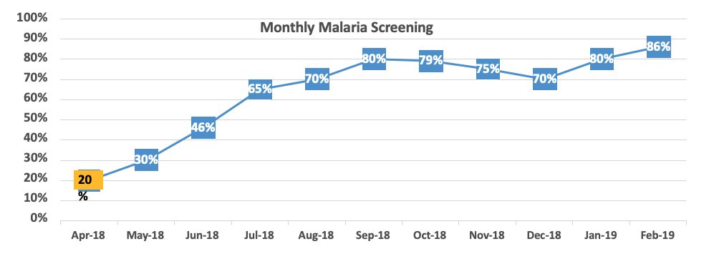
So why is it important to measure?
Separates what you think is happening from what is
Establishes a baseline and shows progress over time
Notes:
Can anyone define what an indicator is? It is a sign of progress – used to determine whether a program is achieving its objectives
Qualitative: help to supplement numbers/percentages provided by quantitative
What is the difference between process, outcome, and impact indicators?
Process: measure activities carried out to achieve a program objective, butts in a seat! But what have the people have been trained done with their knowledge/skills, how have they changed their behavior
Outcome: immediate results through the execution of activities
Impact: long-term effects or end results of a program, e.g. change in health status, reduction in mortality, morbidity

Slide 6
What is data?
Information such as numbers, words or observations that represents activities done
Examples:
Number of people who visited a clinic on Friday
Comments from the suggestion box
Data are the voice of the system
Notes:
I would like to hear from each task team how they went about selecting indictors.
Practical: can be collected on a timely basis and at a reasonable cost
Independent: non-directional, can vary in any direction, e.g. # of people using LLINs rather than an increase in the # of people using LLINs
Reliable: can be measured repeatedly with precision by different people
Relevant: extent to which a result can be attributed to an activity
Linkage of action plan indicators to national, regional, global indicators: Henry will cover this.

Slide 7
Quantitative Data: Counting Things
5 Jelly Beans or
1 Red Jelly Bean
1 Green Jelly Bean 1 Orange Jelly Bean
1 Pink Jelly Bean
1 Purple Jelly Bean

Slide 8
Quantitative Data: Describing Things
There are red, green, orange, pink and purple Jelly Beans
Each of the Jelly Beans is oval shaped and about the same size
They all taste delicious

Slide 9
Which one is an example of quantitative data?
Number of people who visit the clinic on Friday
Comments from the suggestion box

Slide 10
Group Activity: Types of Data
10 minutes discussion, 10 minutes feedback
Step 1: Form small groups
Step 2: Select 2 people (Scribe/ Presenter) in your small group
Step 3: Members of each small group should work together to come up with examples of quantitate and qualitative data
Step 4: The Scribe is responsible for writing the examples agreed upon
Step 5: The Presenter is responsible for reporting back to the larger group
The group with the most examples wins!

Slide 11
Performance Measurement and Quality Improvement
You can’t improve what you can’t measure.

Slide 12
Reasons to Measure in Health Care
It shows where the challenges are
It shows whether there is improvement
Separates what you think is happening from what really is happening
Shows the starting point
Helps in identifying problems as they appear
Allows for comparison across healthcare facilities and regions

Slide 13
Performance Measurement vs. Standards of Care
Performance measurement = an indication of the healthcare organization’s performance
Standard of care = the expected quality of care that should be given to everyone

Slide 14
What is an indicator?
Shows the true state or level of something
There are different types of indicators such as:
Time
Speed
Temperature
Weight

Slide 15
What is a quality indicator?
A quality indicator shows what is happening and if the set of standards are met
Examples:
IRS of all targeted structures 100%
Test all suspected malaria cases 100%
Treat all confirmed malaria cases 100%

Slide 16
Characteristics of a Good Quality of Care Indicator
Relevance
Does the indicator relate to a condition that occurs frequently or have a great impact on your program?
Measurability
Can the indicator realistically and efficiently be measured?
Accuracy
Is the indicator based on acceptable standards or guidelines?
Achievable
Can the performance rate associated with the indicator realistically be improved?
Time bound
Does it apply to services provided within a defined period?

Slide 17
Development of an Indicator
Specify the reasonable requirement for care
Define the measurement population
Gender
Age
Define the time-frame
1 week
3 months
Define the indicator as a question
What is the Hepatitis B vaccination coverage of health care workers in the facility or region?

Slide 18
Examples of Indicator Development
Specify the reasonable requirements for care (e.g. All suspected malaria cases presented at the facility must be tested with RDT)
Set the denominator
Specify which cases should be getting care
Suspected malaria cases presented at the facility
Set the numerator
Which suspected malaria cases got the care/ tested?
The number of suspected malaria cases tested with RDT

Slide 19
Summary: Indicator Development
Denominator: Suspected malaria cases
Numerator: Suspected malaria cases tested with RDT

Slide 20
How Indicators Can Be Displayed

Slide 21
Key Points
Performance measurement is important in order to improve quality of healthcare services
There are two types of data: qualitative and quantitative
Indicators measure the true state or level of something
Quality indicators measure specific aspects of healthcare

Slide 22
Model for Improvement
Notes:
Acknowledge hard work of the TTs in developing work plans
Warn that this is a presentation is participatory

Slide 23
Model for Improvement
What are we trying to accomplish?
How will we know that a change is an improvement?
What change can we make that will result in improvement?
Model for
Improvement
Act Plan
Study Do
Source: Associates in Process Improvement

Slide 24
The Plan-Do-Study-Act (PDSA) Cycle
ACT
Adopt?, Adapt?, Abandon?
Increase the scale?
Test under different conditions?
Next cycle?
PLAN
Plan the test
What, Who, How, Where, When
Remember to plan data collection
STUDY
What happened? What’s the data telling us?
Summarize what was learned
DO
Carry out the plan
Document what happened and any unexpected observations
Source: Associates in Process Improvement

Slide 25
Example of a PDSA Cycle 1
Problem: Data shows that 70% patients with confirmed malaria received appropriate anti-malaria treatment according to the national guideline
TT Members to provide in-service training to 16/20 untrained clinicians (Drs, Nurses) in the facility on case management
Mondays and Wednesdays
Week: TBD
The change idea needs to be adopted
Provide refresher training
to 4 clinicians
Provide treatment algorithm
ACT
PLAN
81% of malaria cases were treated correctly
Treatment algorithm is not correctly followed in all cases
4 previously trained clinicians are not 100% conversant with Rx algorithm
STUDY
DO
TT train a minimum of 4 clinicians weekly
Perform pre-and post
assessment
16 clinicians trained by date

Slide 26
Example of a PDSA Cycle 2
Problem: Data shows that 81% of patients with confirmed malaria received appropriate anti-malaria treatment according to the national guideline
TT Members to provide refresher training to 4/20 previously trained clinicians (Drs, Nurses) in the facility on case management
Week: TBD
Adopt the change idea and continue close monitoring and regular measurement
ACT
PLAN
STUDY
DO
92% of malaria cases were treated correctly
Algorithm prove to be useful and appreciated
Refresher training provided to 4 clinicians
Perform pre-and post
assessment

Slide 27
Why Test?
Increases our confidence that the idea is leading to an improvement
Enables us to observe a change under different conditions
Allows successful adaptation of an idea
Evaluates costs and unexpected consequences
Minimizes resistance to implementation

